Slide 1


INDUSTRIAL
VISIT
Tirth Shah, 22BCP230

Slide 2
Content
01
Introduction
02
ISRO-SAC-VSSE
03
eInfochips
04
SLTL
05
Conclusion

Slide 3


INTRODUCTION

Slide 4


OBJECTIVES OF INDUSTRIAL VISIT
Real-World Exposure
Networking Opportunities
Skill Development
Experience industry practices and real-world applications of theory
Connect with industry professionals and explore career prospects.
Learn latest technologies and tools for future career readiness

Slide 5
INDUSTRIES VISITED
ISRO-SAC-VSSE
eInfochips
SLTL
Showcases SAC’s space contributions, with engaging exhibits and detailed explanations
Provides advanced AI, embedded systems, and interdisciplinary products, with effective team management and engaging exhibits
Offers innovative laser solutions across various industries, transforming facilities with high-end technology

Slide 6
ISRO-SAC-VSSE

Slide 7
ISRO-SAC-VSSE
INTRODUCTION
HIGHLIGHTS
ISRO-SAC: The Space Applications Centre (SAC) is a unit of ISRO focusing on space-based applications.
Vikram Sarabhai Space Exhibition (VSSE): A showcase of SAC’s advancements in space technology and GIS softwar
SAC’s GIS Software: Widely used globally for scientific and engineering purposes.
Key Achievements: Contributions to satellite technology, space research, and remote sensing.
Exhibition Features: Demonstrations of SAC’s journey, innovations, and milestones.

Slide 8
ISRO-SAC-VSSE
Detailed Observations
Educational Value
Technological Impressions: Insight into SAC’s role in developing GIS software and space technology.
Exhibition Highlights: Effective display of SAC’s history and contributions through detailed descriptions and interactive elements.
Enhanced Learning: The exhibition provided a comprehensive understanding of SAC’s contributions to space and GIS technologies.
Impact: Gained a deeper appreciation for SAC’s innovations and their impact on various scientific fields.

Slide 9
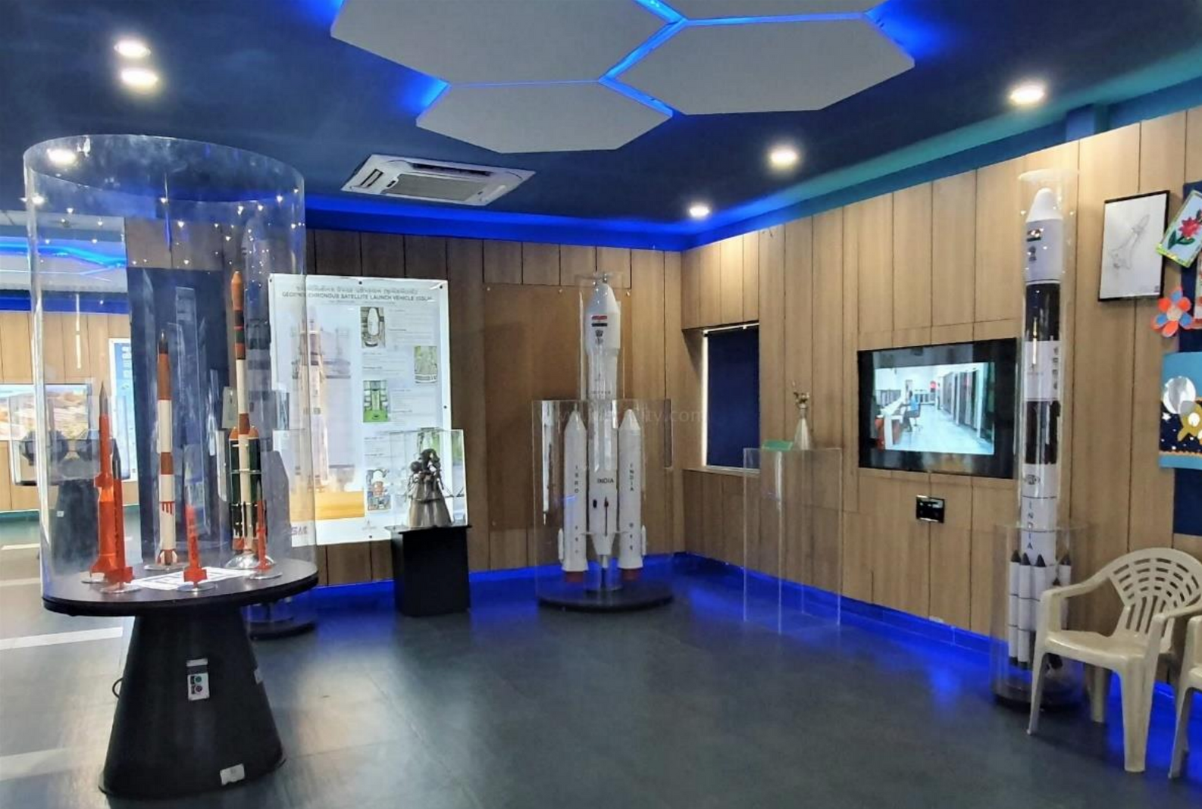
ISRO-SAC-VSSE

Slide 10
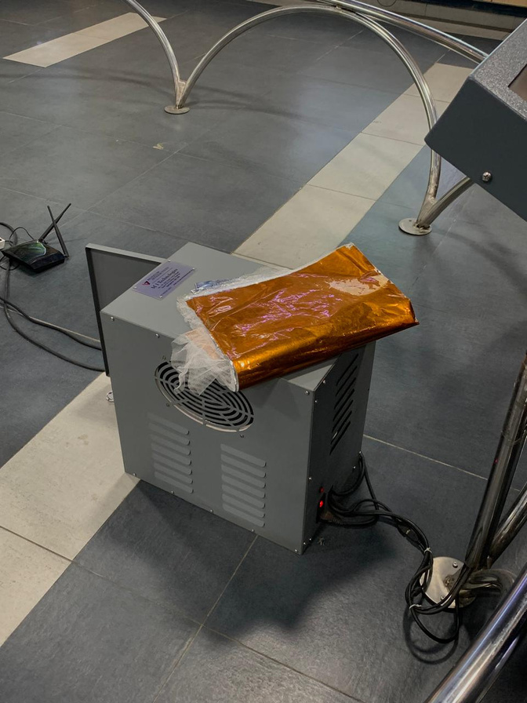
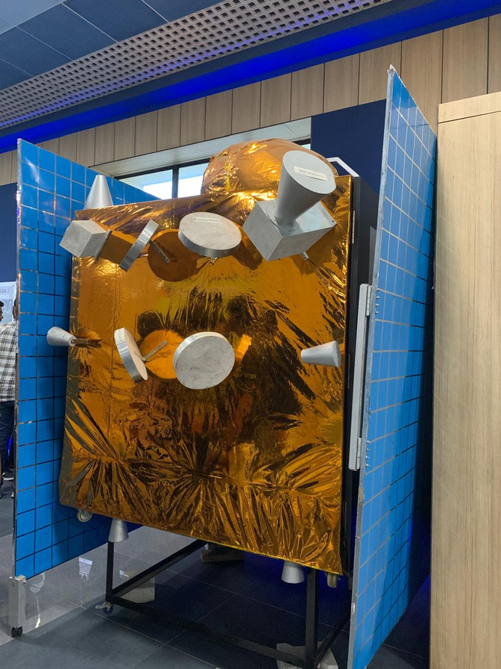
ISRO-SAC-VSSE

Slide 11
E-INFOCHIPS

Slide 12
E-INFOCHIPS
INTRODUCTION
HIGHLIGHTS
eInfochips: A leading technology firm specializing in AI, embedded systems, and product engineering.
Focus Areas: Advanced technology solutions across various sectors including IoT, AI/ML, and embedded systems.
Key Products: Innovations in AI and embedded systems.
Team Management: Effective coordination in developing interdisciplinary products.
Exhibition: Showcase of cutting-edge technologies and product demonstrations.

Slide 13
E-INFOCHIPS
Detailed Observations
Educational Value:
Technological Impressions: Notable advancements in AI and embedded systems.
Management Insights: Effective team management and timely delivery of interdisciplinary products.
Key Products: Innovations in AI and embedded systems.
Team Management: Effective coordination in developing interdisciplinary products.
Exhibition: Showcase of cutting-edge technologies and product demonstrations.

Slide 14
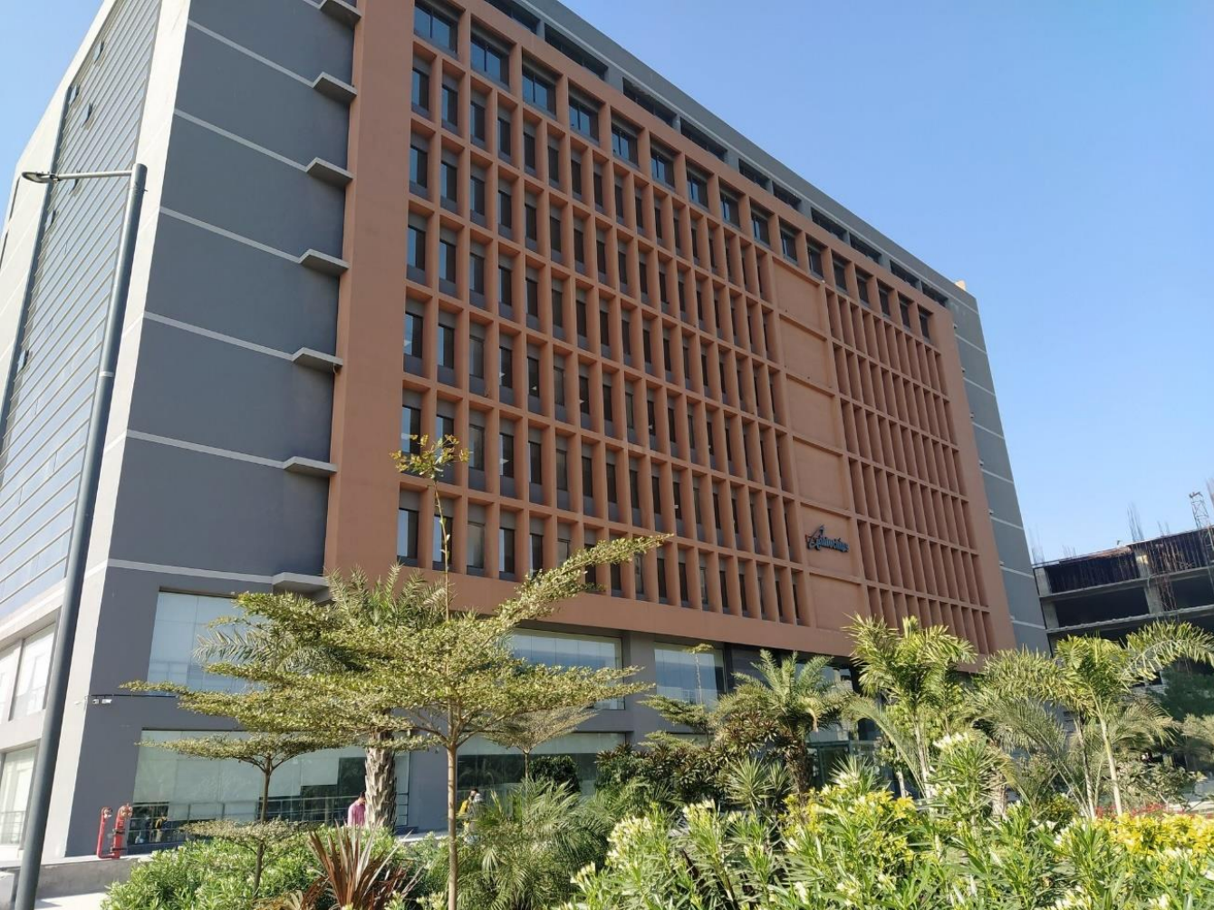
e-Infochips

Slide 15
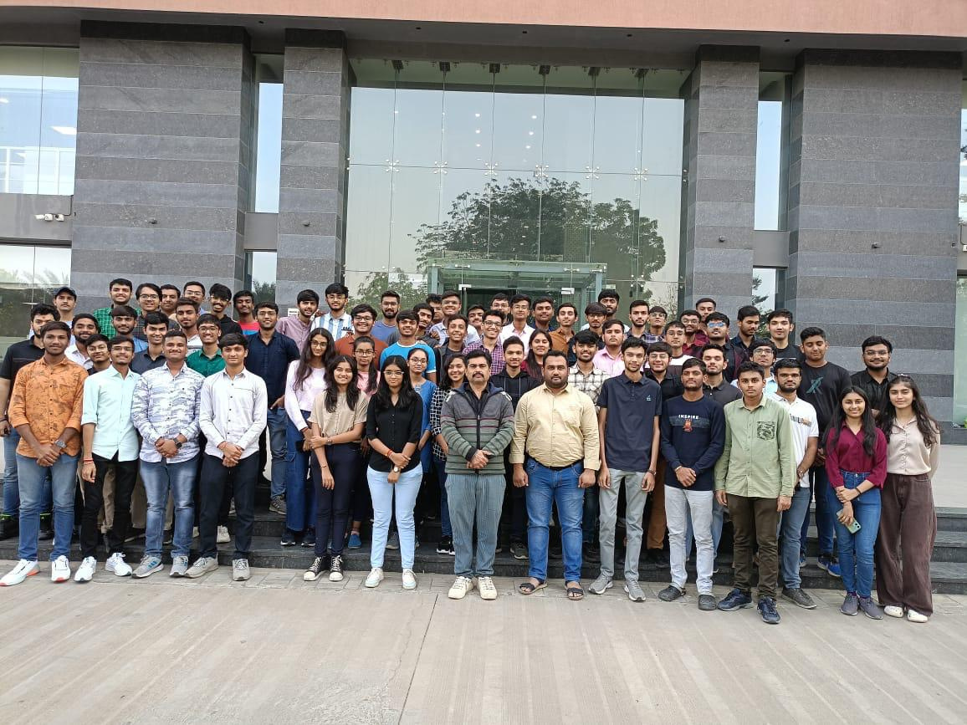
e-Infochips

Slide 16
SAHAJANAND LASER TECHNOLOGIES LIMITED

Slide 17
SLTL
INTRODUCTION
HIGHLIGHTS
SLTL: Sahjanand Laser Technologies Limited, specializing in laser solutions across various industries.
Focus Areas: Laser Systems, Medical, Diamond & Jewellery, RF & Microwave, and Hi-Tech Software Solutions.
Innovative Solutions: Advanced laser frameworks and high-tech products.
Industry Transformation: Technology designed to enhance and smarten industrial facilities.

Slide 18
SLTL
Detailed Observations
Educational Value
Technological Impressions: Innovative laser solutions and their applications across different sectors.
Impact: How SLTL’s high-end technology is transforming industrial facilities into smart operations.
Learning Experience: Gained insights into the latest advancements in laser technology and its practical applications.
Impact: Enhanced understanding of SLTL’s contributions to various fields through their innovative solutions.

Slide 19
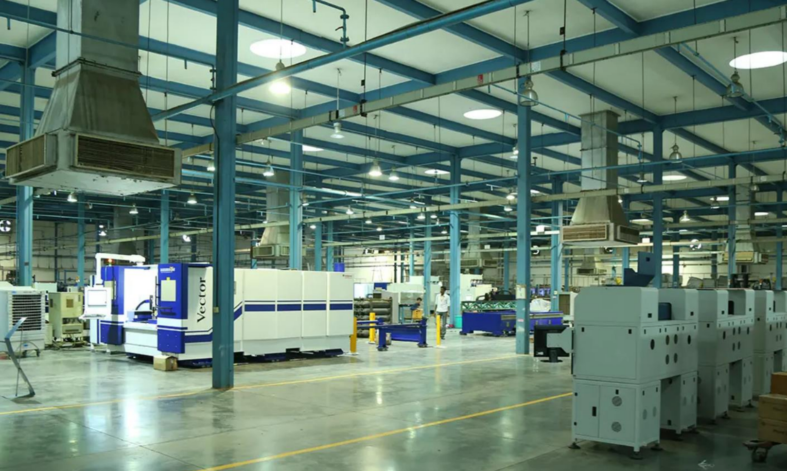
SLTL

Slide 20
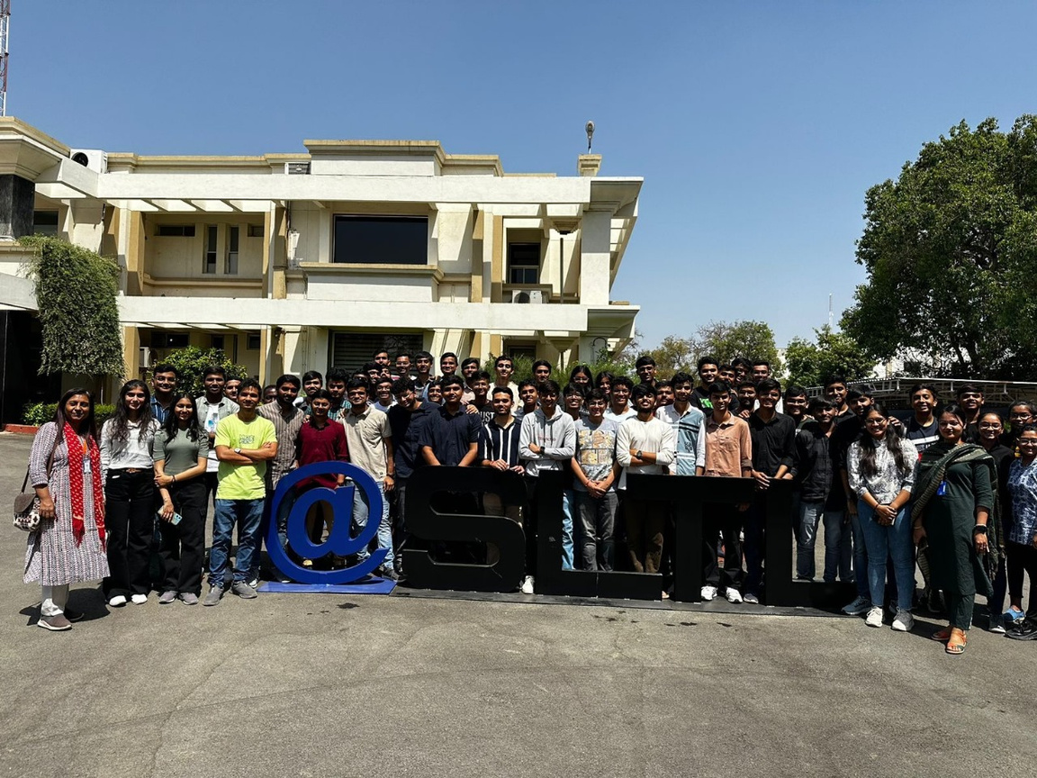
SLTL

Slide 21
CONCLUSION

Slide 22
Conclusion
The visits to ISRO-SAC-VSSE, eInfochips, and SLTL offered invaluable insights into cutting-edge technologies and industry practices.
Each organization demonstrated significant advancements in their respective fields, enhancing our understanding of space technology, AI, and laser systems.
These experiences have not only broadened our knowledge but also highlighted the importance of innovation and effective management in driving technological progress.

Slide 23
Thank You

